Slide 1
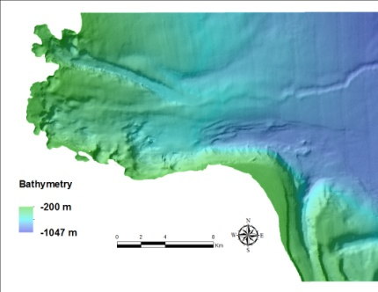
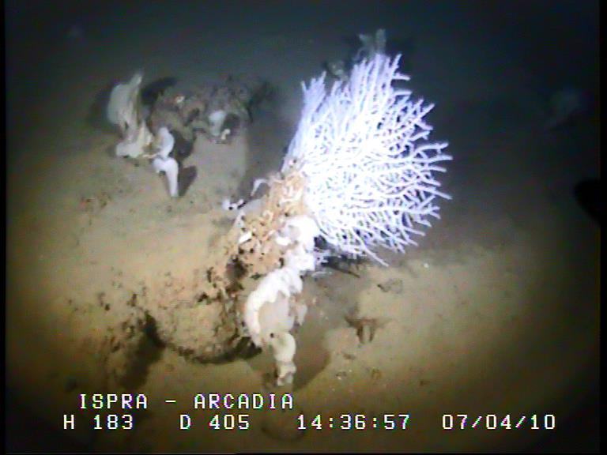
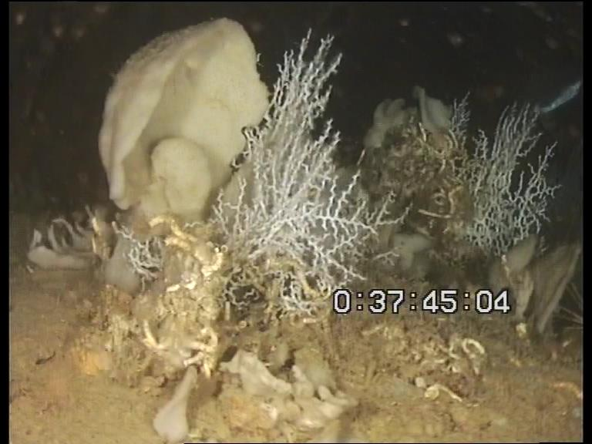
Habitat Suitability model for Bari Canyon with Hydrodynamic variables
Workshop on Habitat models, Toulon, 16-17th nov. 2015

Slide 2
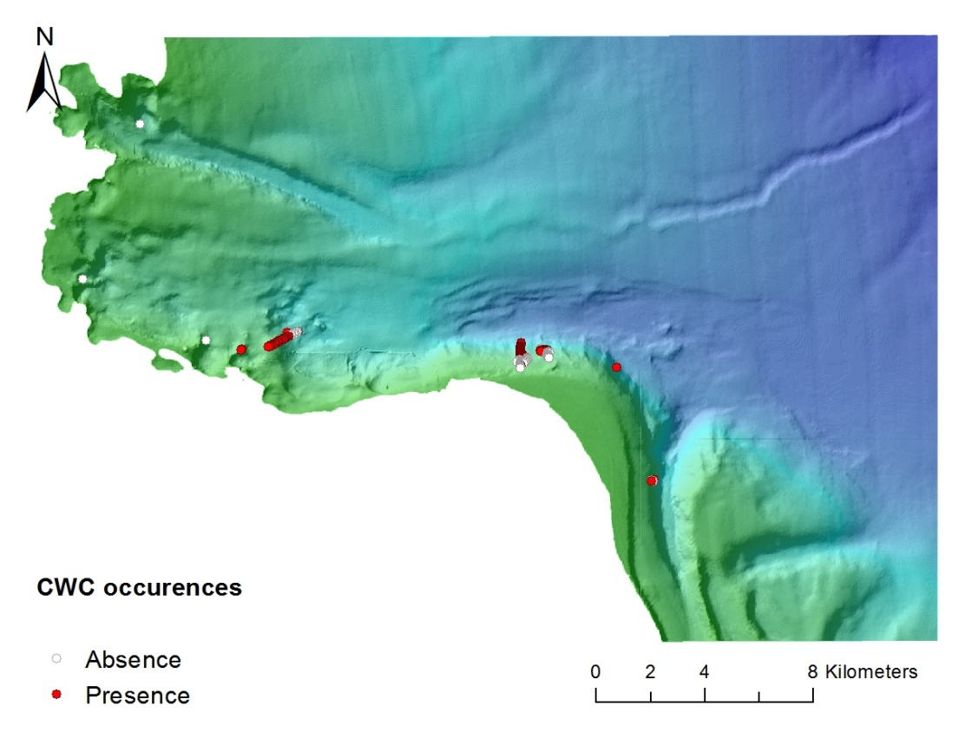
Bari Canyon System
Number of occurences | Bari Canyon System
Presence Points | 132
Absence Points | 94
- 1 major oceanographic cruise
- 2Transects from litterature
(Freiwald et al. 2009)
- Samples
- Hydrodynamic data (D. Bonaldo)
Presence data are clustered in the same area
of the canyon system

Slide 3
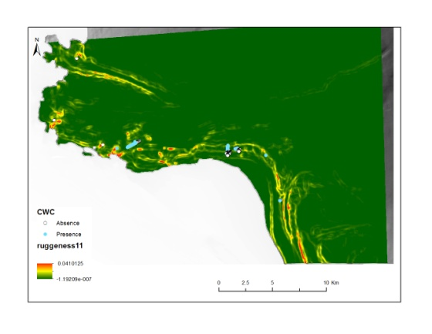
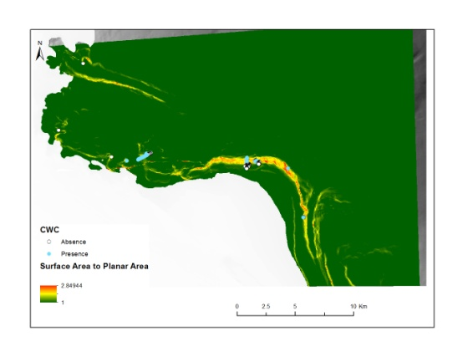
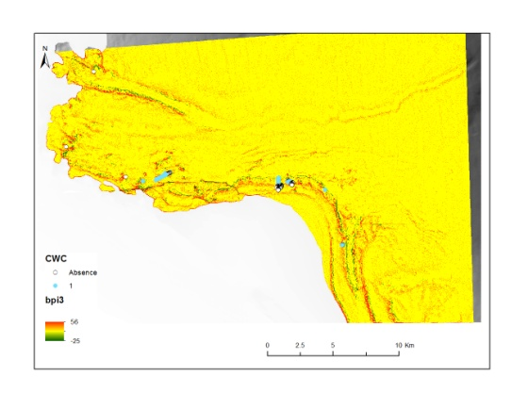
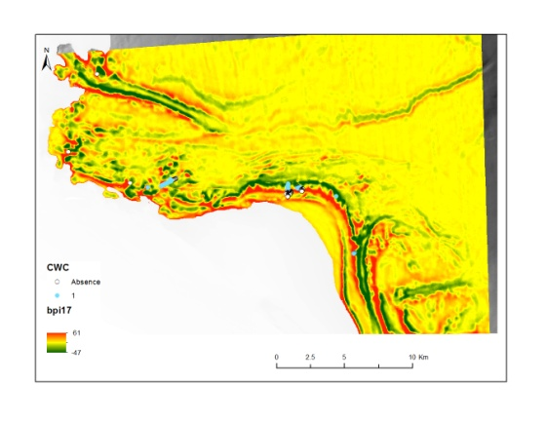
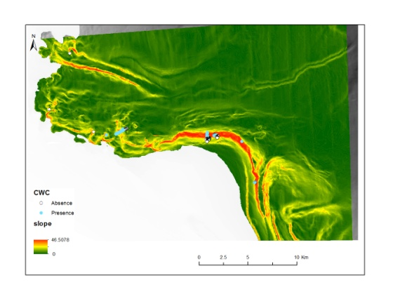
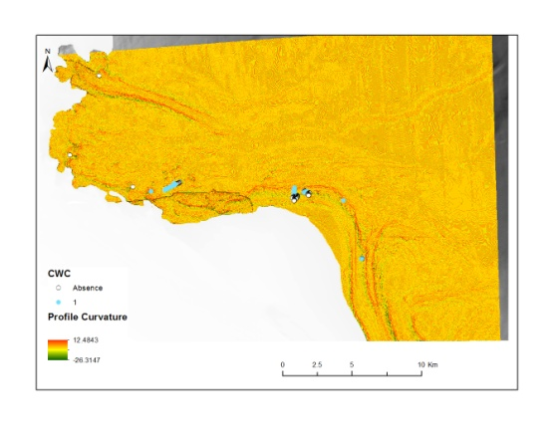
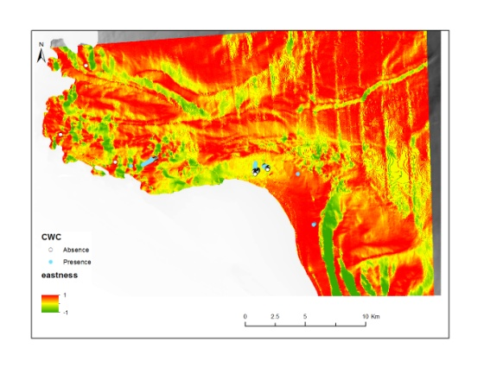
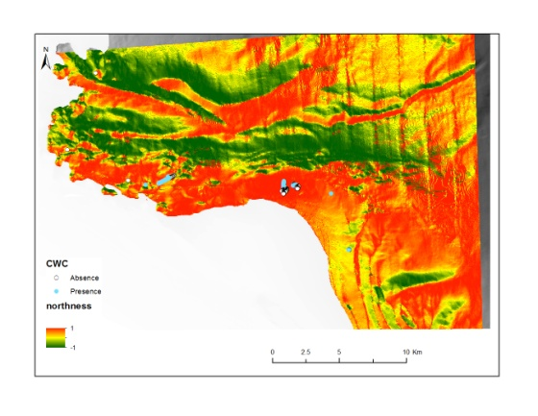
Derived Bathymetric data
Use of bathymetry (20 m resolution) to build raster of EGVs
Terrain roughness
Topography
Ruggedness (3)
Surface Area to Planar Area
Bathymetric Position Index (6)
Slope
Curvature
(Profile and transversal)
Orientation
Eastness
Northness

Slide 4
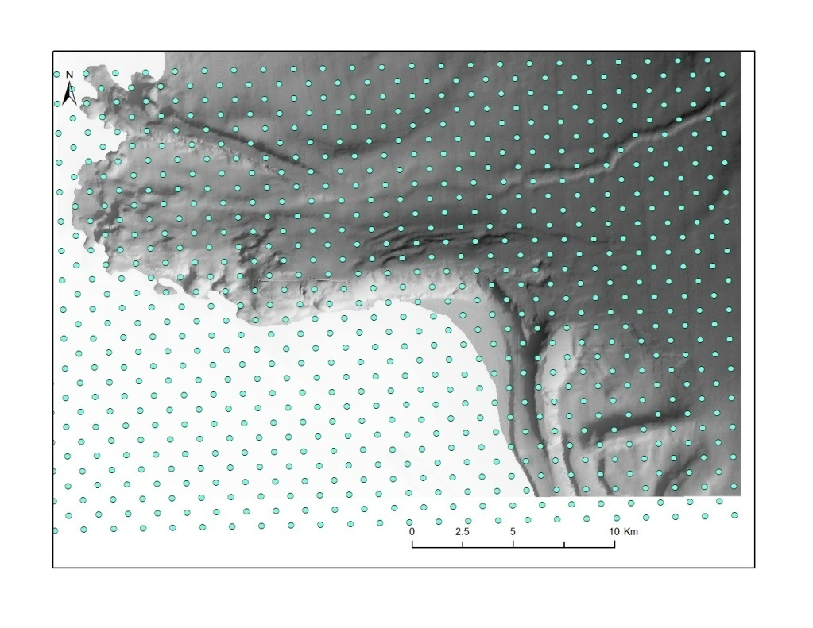
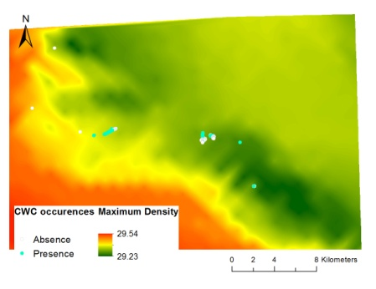
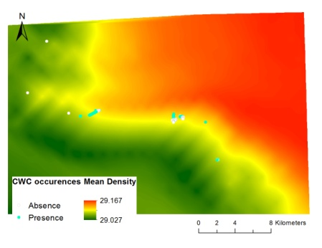
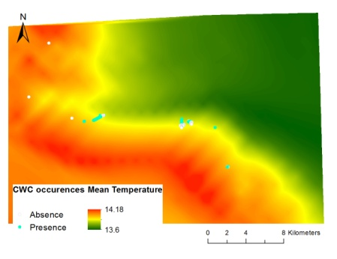
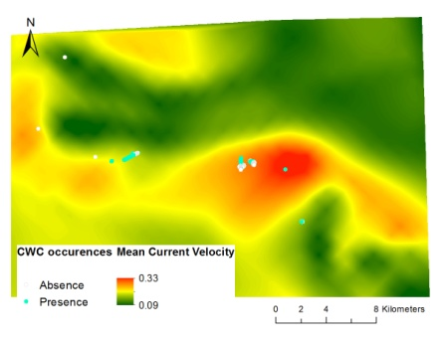
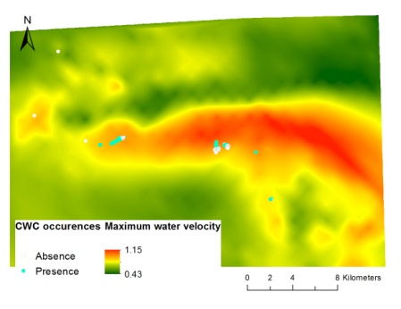
Hydrodynamic data (Davide)
implementation of ROMS for ocean currents, coupled with SWAN within the COAWST modelling system
From Nov. 01st,2011 to June 28th, 2012 (8 months)
-> Exceptional winter conditions (cold event)
1km resolution
Min, Max and Mean
Density
Temperature
Salinity
Current velocity
Hydrodynamic Points every 1km
Interpolation using natural neighbor (Arcgis)
Max density
Mean density
Mean temperature
Mean Current velocity
Max Current velocity

Slide 5
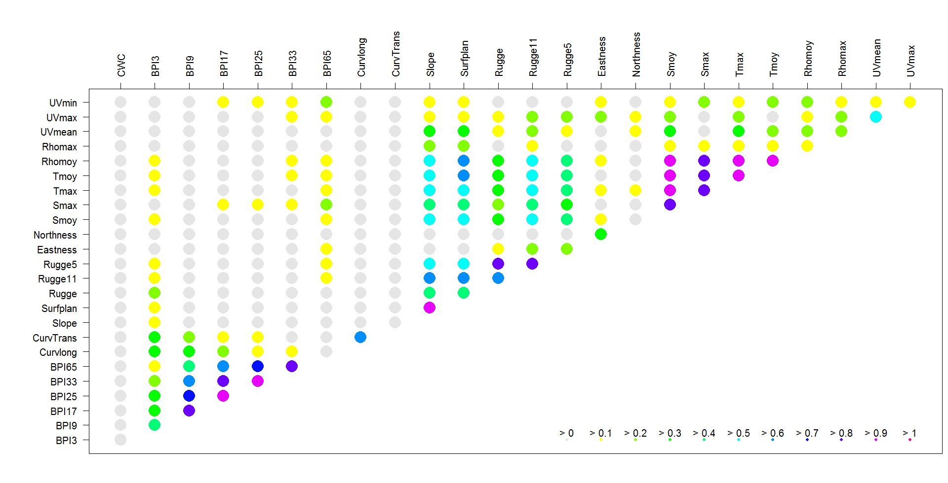
Selection of the best EVGs
For Habitat suitability model, non-correlated variables are recommended
→ Study of correlation (Spearman cor. + PCA)
→Study of variable influences on CWC distribution
On the whole zone

Slide 6
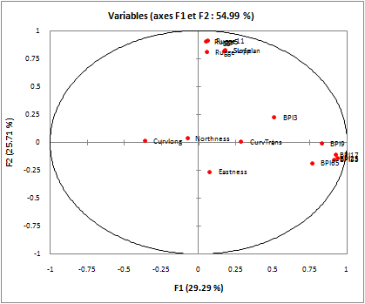
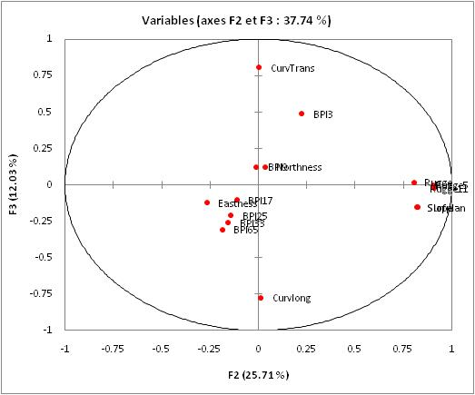
PCA on bathymetric variables
Selected bathymetric variables : BPI17, Slope, Rugge11, CurvLong, Eastness, Northness and BPI3

Slide 7
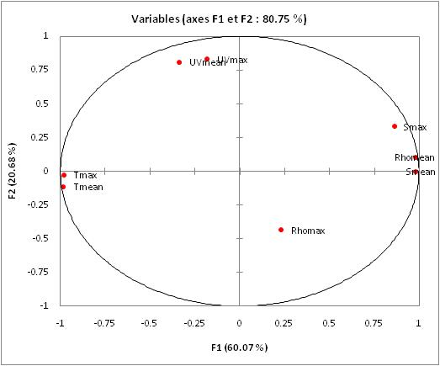
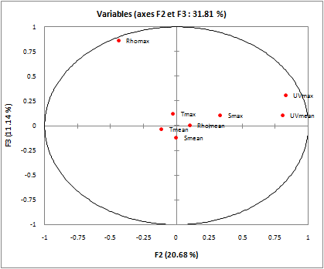
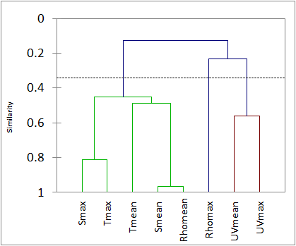
PCA on Hydrodynamic variables
Selected variables :
Uvmean, Tmean and Rhomax

Slide 8
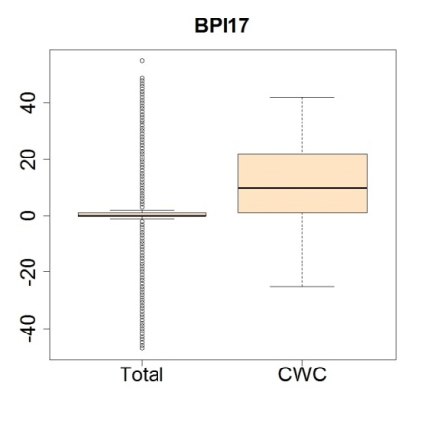
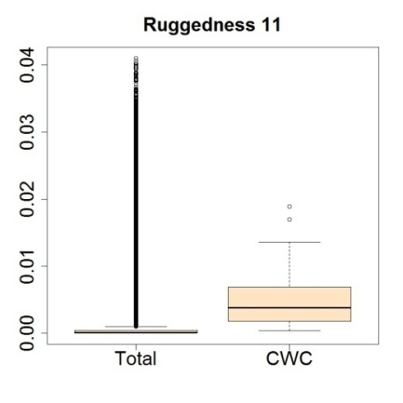
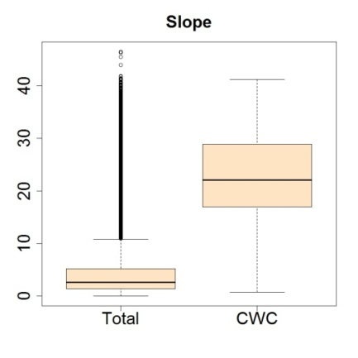
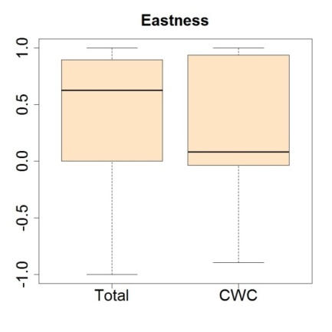
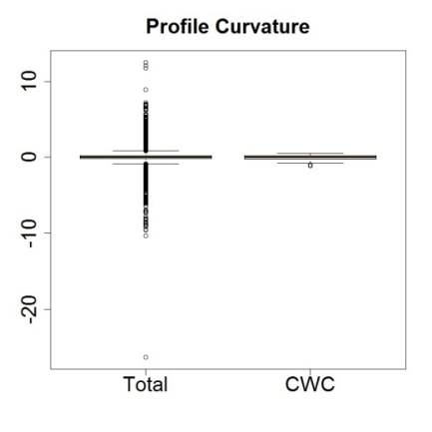
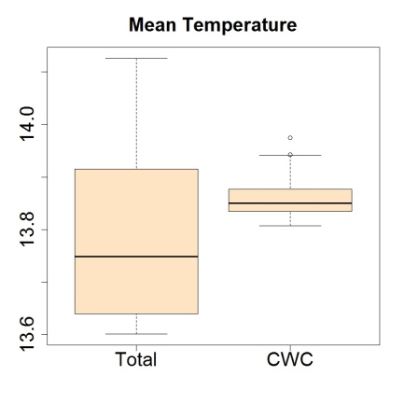
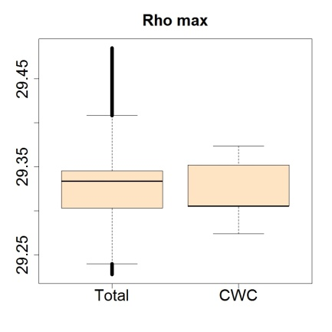
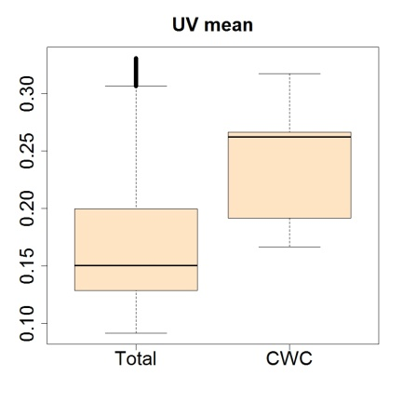
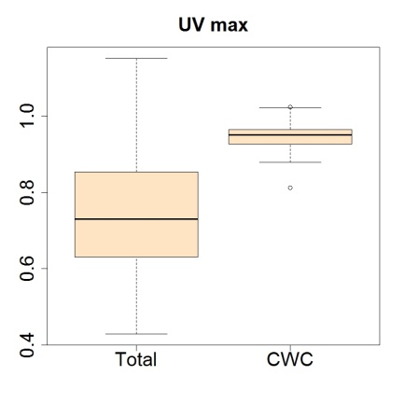
Best EGV for CWC study
BPI17, BPI3, Slope and Ruggedness 11, Profile Curvature, Eastness, Northness
UVmean, UVmax, Tmean and Rhomax

Slide 9
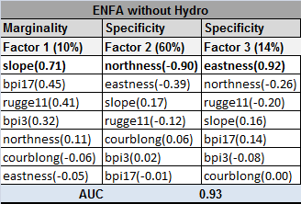
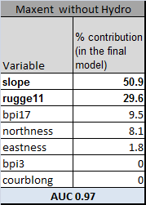
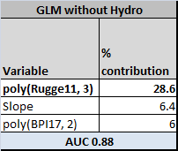
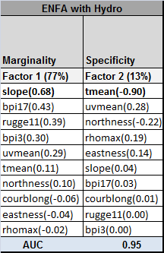
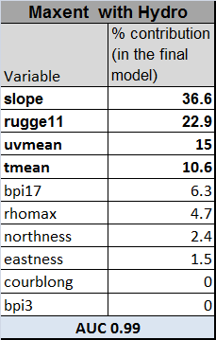
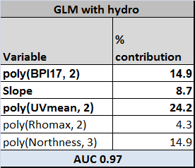
Variables explaining the distribution of CWC in the
Bari Canyon system with and without hydrodynamic data
marginality (niche position in the ecological space)
Without Hydrodynamic data
specificity (niche size) = 1/tolerance
Slope and Ruggedness are the main variables for the 3 models
Slope explains the marginality (niche position) and Orientation explains the specificity (niche size)
Witht Hydrodynamic data
ENFA: Slope explains the marginality (niche position) and Tmean explains the specificity (niche size) (instead of Orientation)
- The tolerance of the CWC is lower when hydrodynamic variables are used in ENFA
MAXENT: Slope and Ruggedness are still important but Uvmean and T mean also
GLM: Ruggedness (poly) is still the main variable but UV mean is also important
For ENFA, UVmax was not used (eigenvalues too high)

Slide 10
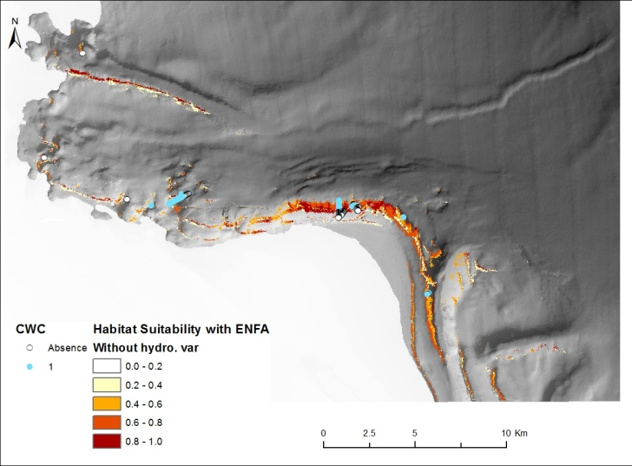
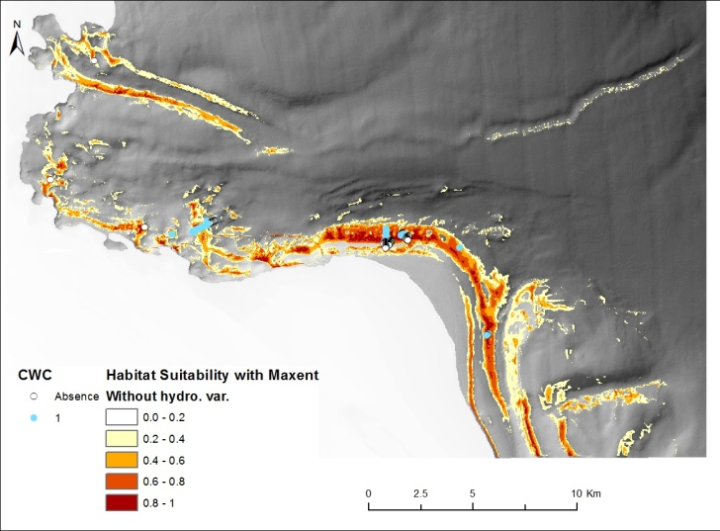
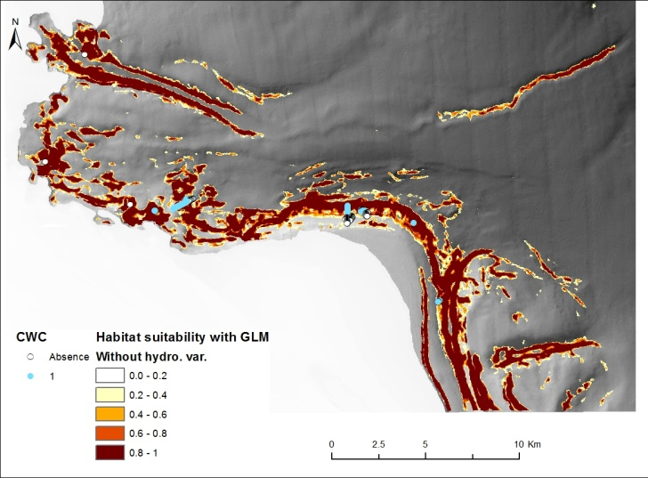
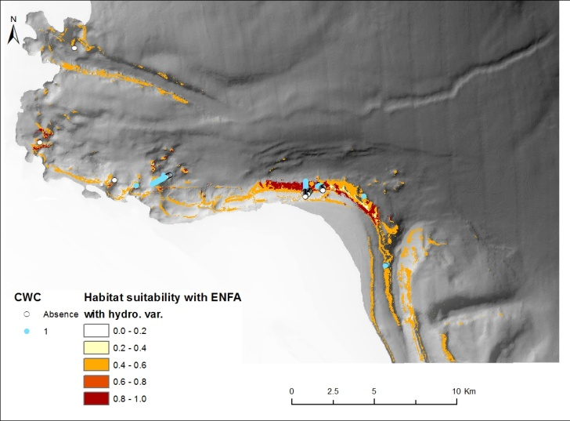
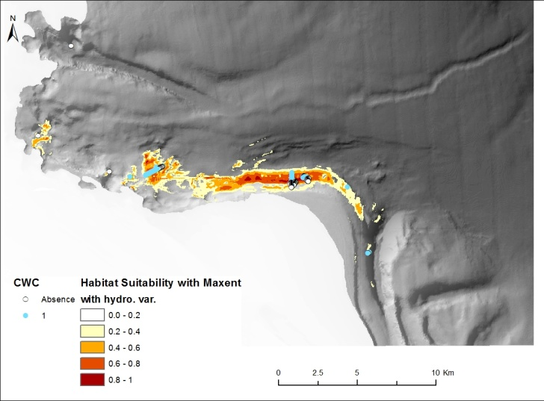
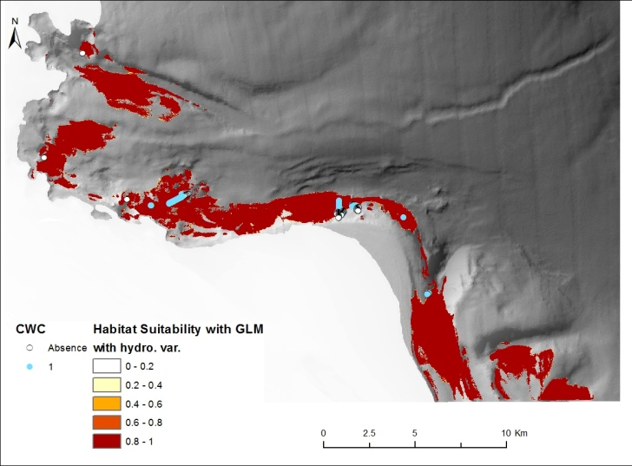
Habitat suitability for each pixel in relation to the background of the study area
Without HydroD
ENFA
MAXENT
GLM
without UVmax
Witht HydroD
ENFA
MAXENT
GLM
Change in the probability
of some suitable areas
Selection of more
probable suitable areas
Selection of more
probable suitable areas

Slide 11
Questions
The data of the hydrodynamic models occurred during cold extreme climatic event → How can we draw conclusions with those data ?
With Hydrodynamic data the new models seems to be very discriminative.
How can we exclude the extreme event data from the dataset Davide gave us? Percentile 95? Percentile 98? Data before the event?

